Slide 1
Building a global climate regime from the bottom-up (“Staged Accession Scenarios”)
Mitigation pathways in the context of fragmented climate policies
Elmar Kriegler (PIK), Keywan Riahi (IIASA), Jana Schwanitz (PIK), Adriana Marcucci (PSI), Leonidas Paroussos (ICCS), the AMPERE Consortium
The AMPERE project in funded by the European Union’s Seventh Framework Programme FP7/2010 under grant agreement n° 265139 (AMPERE)

Slide 2
Acknowledgement
The AMPERE project in funded by the European Union’s Seventh Framework Programme FP7/2010 under grant agreement n° 265139 (AMPERE).
The information presented here reflects only the authors’ views. The European Union is not liable for any use that may be made of the information contained herein.

Slide 3
Key findings

Slide 4
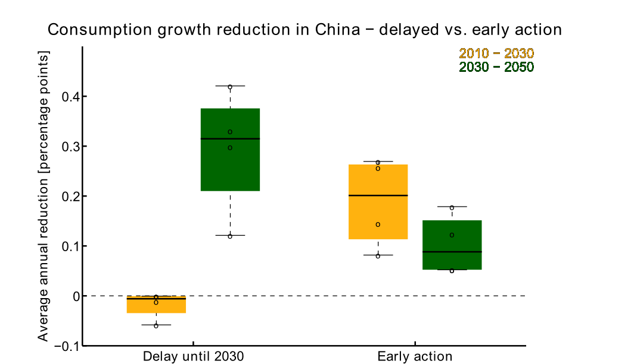
Countries face a trade-off between early vs. delayed action on long-term climate targets
Regions need to strengthen action at some point to reach climate targets
Early movers have higher near term mitigation costs
Late movers face higher transitional impacts later on
Co-benefits can play large role (e.g. air quality)

Slide 5
EU can afford to unilaterally commit to stringent emissions reductions
EU Roadmap (-40/-80% in 2030/50) moderately stronger than reference policy (-30/-40% in 2030/50)
Only moderate costs of adopting the roadmap (0-0.8 percentage points higher than in reference case)

Slide 6
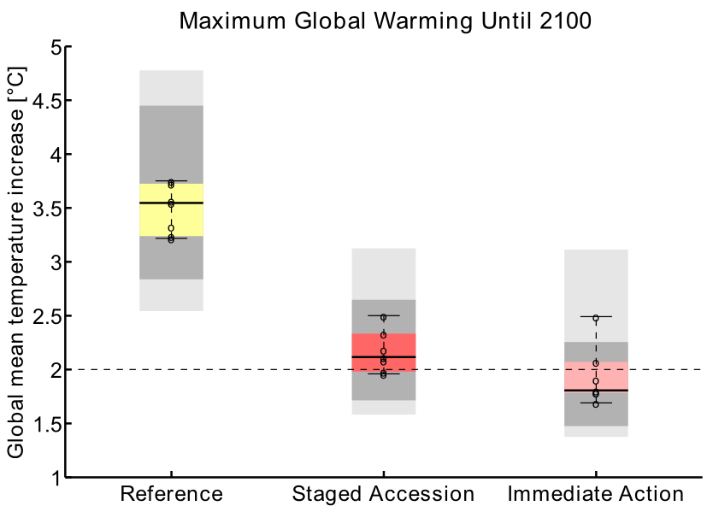
Signalling commitment to ambitious climate targets will bring large climate benefits if others follow
Signalling effect of early mover action is key.
Without staged accession by major emitters, no warming benefit.
EU roadmap can be a signal,
since it is consistent with EU action in 2ºC scenarios.

Slide 7
Signalling commitment to ambitious climate targets will bring large climate benefits if others follow
Signalling effect of early mover action is key.
Without staged accession by major emitters, no warming benefit.
EU roadmap can be a signal,
since it is consistent with EU action in 2ºC scenarios.
Warming can be reduced significantly
if other major emitters join stringent action by 2030 (staged accession).
The 2ºC target is likely surpassed temporarily
in a staged accession setting (by 0.5ºC or less).

Slide 8
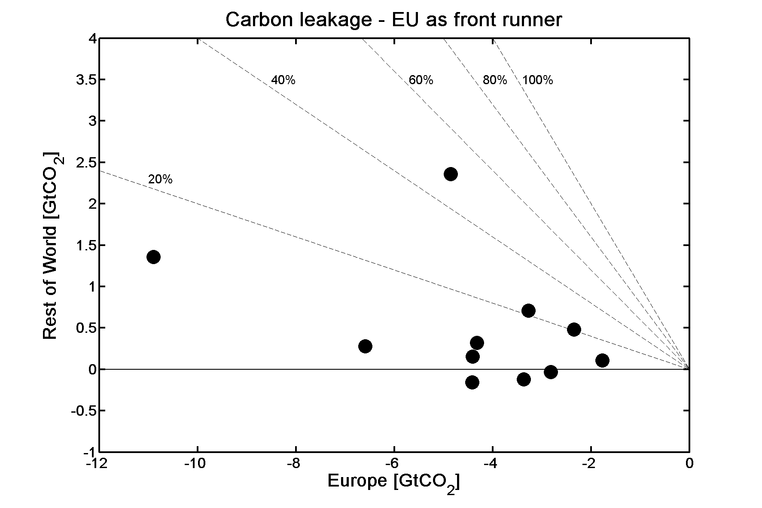
Carbon leakage from EU is limited if others pursue moderate action until 2030
Carbon leakage rate 20% or smaller
Leakage in energy intensive industries (GEM-E3 results):
max. 30% leakage rate
max. 1.5% output reduction in any sector

Slide 9
Detailed findings

Slide 10
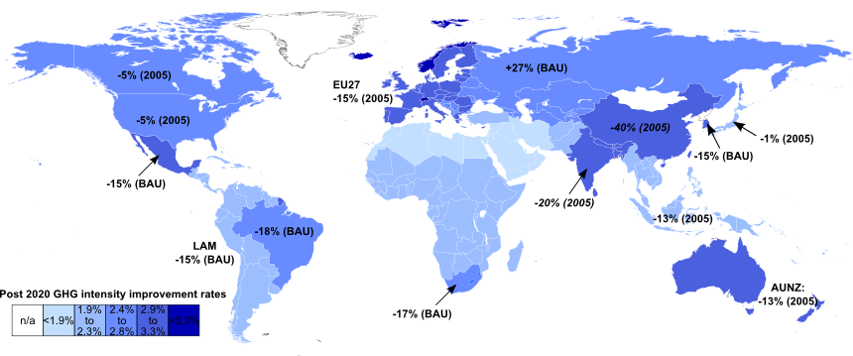
Reference case: a fragmented climate policy landscape
Diverse national energy/climate policies, mixed progress on 2020 pledges
AMPERE reference policy:
Regional 2020 emissions targets (China & India: intensity targets)
Regional RE quotas for electricity (2020)
Capacity targets for Wind, Solar, Nuclear (2020-30)
Extrapolation of GHG intensity improvements beyond 2020

Slide 11
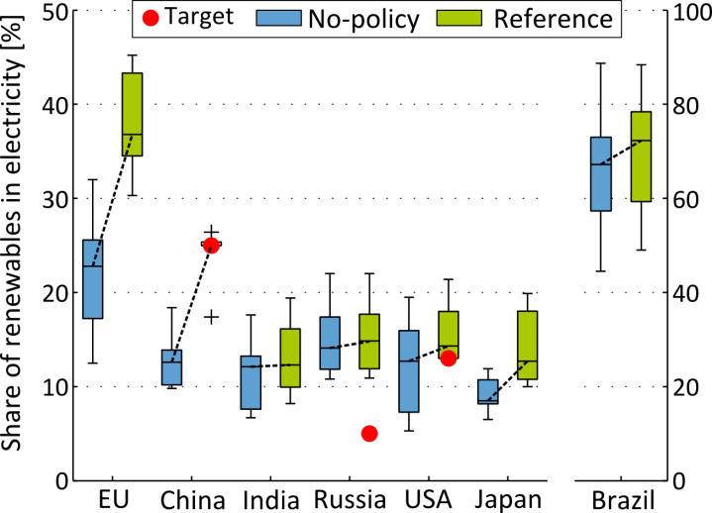
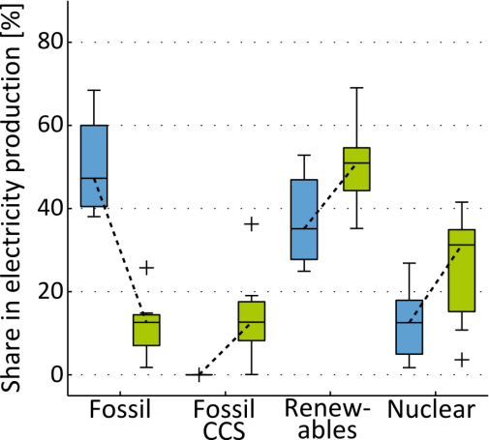
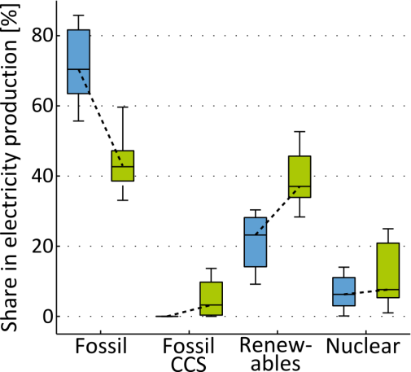
Technology deployment in the reference case
Compared to a scenario without any climate policy, the reference case sees a shift in electricity production from fossil fuels to fossil with CCS, renewables and nuclear.
Until 2020: impact of reference climate policies and technology targets
2030-2100: impact of continued reference mitigation policies
Europe
China
World-EU-China

Slide 12
The Mitigation Challenge
80
No Policy
70
Extrapolation of current policies
60
50
40
GHG emissions (GtCO2 equiv.)
30
Strong global action towards the 2ºC target
20
10
0
2000
2020
2040
2060
2080
2100

Slide 13
Staged accession (2030-50) to a strong global climate policy regime after unilateral EU (roadmap) action
80
No Policy
70
Extrapolation of current policies
60
Staged Accession
50
World on „immediate action“ (green) carbon pricing trajectory
40
GHG emissions (GtCO2 equiv.)
30
EU adopts roadmap, ROW follows reference policy
20
ROW transitions to stringent carbon pricing
10
0
2000
2020
2040
2060
2080
2100
Kriegler et al. (2014) Tech. For. & Soc. Change

Slide 14
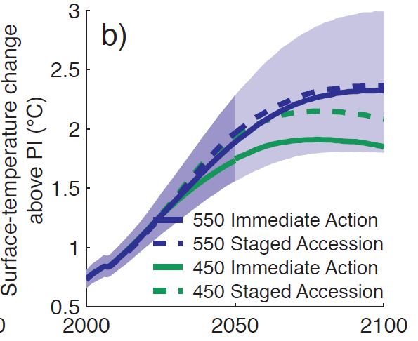
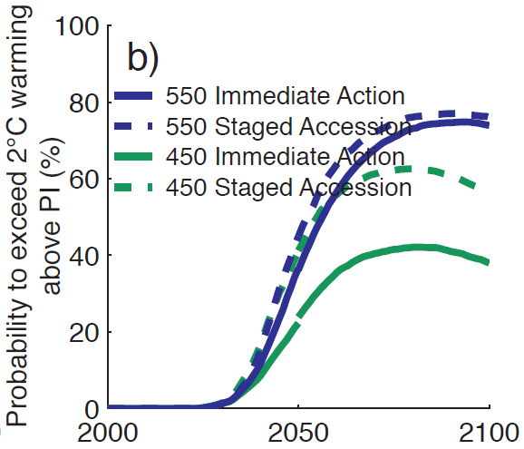
Climate outcome of staged accession
Global mean warming 2ºC exceedance probability
Schaeffer et al. (2014) Tech. For. & Soc. Change, forthcoming

Slide 15
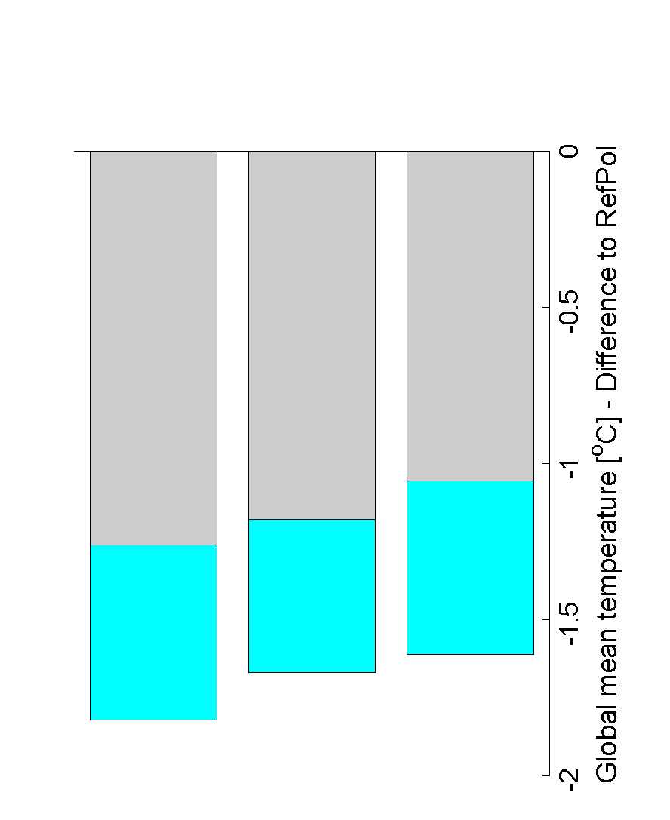
Impact of staged accession on global warming
The 2°C target is likely surpassed temporarily
peak & decline temperature due to negative CO2 emissions in 2100
45-80% exceedance probability
exceedance likely by 0.5°C or less
Warming can still be reduced by more than 1°C
relative to reference policy
Signalling effect of early mover action is key
If ROW does not increase ambition, early action has no warming benefit
Immediate
Action
Staged Accession
(EU + China first)
Staged Accession
(EU first)
Reduction of warming in 2100
relative to reference policy

Slide 16
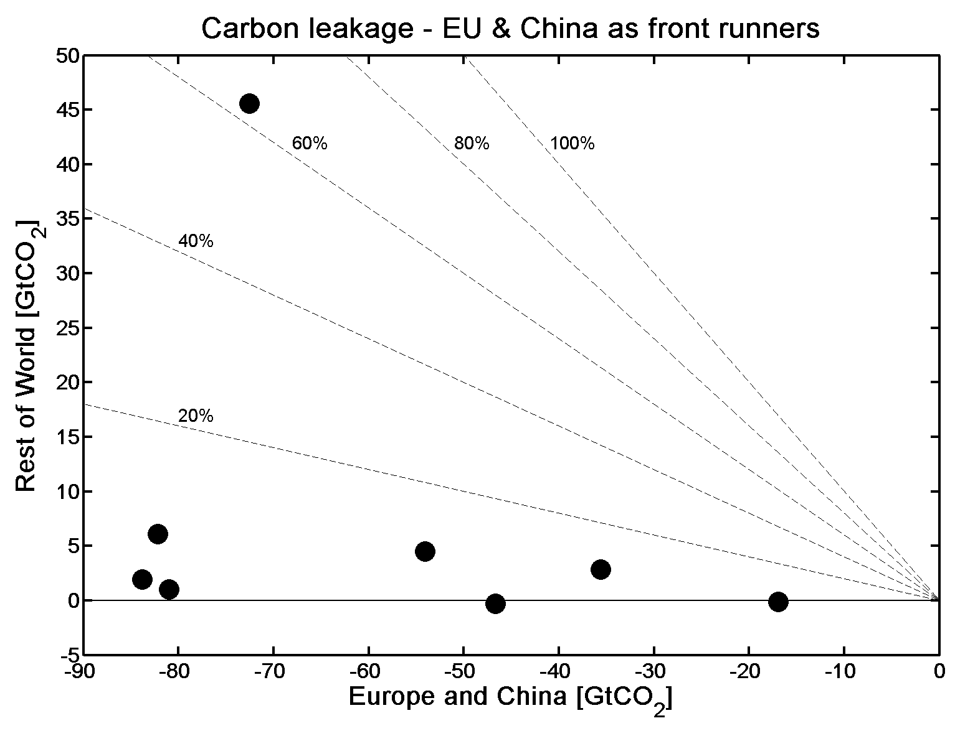
What difference from early action by China?
20-30% less „excess“ emissions until 2050 5-10% higher probability of meeting 2ºC target
No clear effect on EU mitigation costs (largely unaffected in most models)
Considerable impact on 2010-2030 carbon leakage e.g., according to GEM-E3, industry emissions leakage would be reduced from 22% (EU acting alone) to 2% if EU and China acted together
EU alone
EU+China

Slide 17
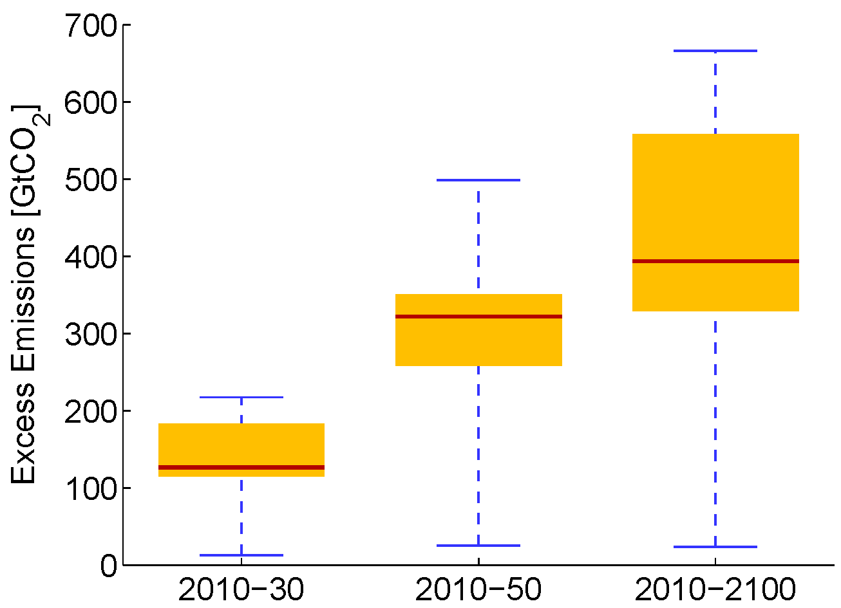
Carbon lock-in in late mover countries persist beyond 2050
Long-term effect of lock-in: for a given level of carbon pricing, emissions remain higher than they would be after early action
Even though near-term “excess” emissions are not compensated, stranded fossil fuel capacity can occur
Transitional challenges are higher
Long-term costs may not be affected under idealized assumptions, but larger institutional challenges (larger carbon market)
Co-benefits (e.g. air quality) play can provide additional incentives not to delay action
Cumulative CO₂ excess
emissions in staged accession vs. immediate action

Slide 18
Special Issue papers on staged accession: (Technological Forecasting and Social Change, 2014)
Kriegler et al. Making or breaking climate targets: The AMPERE study on staged accession scenarios for climate policy
Schwanitz et al. The implications of initiating immediate climate change mitigation - A potential for co-benefits?
Bauer et al. CO₂ emission mitigation and fossil fuel markets: Dynamic and international aspects of climate policies
Schaeffer et al. Mid- and long-term climate projections for fragmented and delayed-action scenarios
Currás et al. Carbon leakage in a fragmented climate regime: the dynamic response of global energy markets
Marcucci et al. Induced technological change in moderate and fragmented climate change mitigation regimes
Paroussos et al. Assessment of carbon leakage through the industry channel: The EU perspective
Otto et al. Impact of fragmented emission reduction regimes on the energy market and on CO₂ emissions related to land use: a case study with China and the European Union as first movers

Slide 19
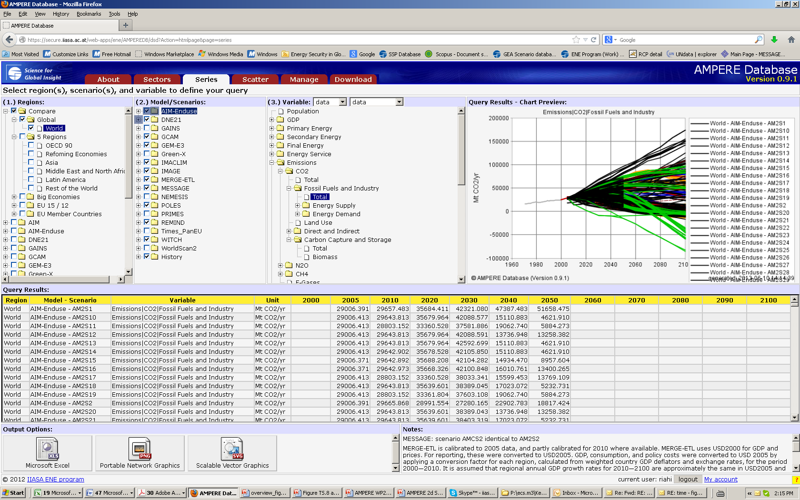
AMPERE Scenarios Database https://secure.iiasa.ac.at/web-apps/ene/AMPEREDB/

Slide 20
Thank You
More information on AMPERE: ampere-project.eu

